Slide 1
Chapter 11

Slide 2
Objectives

Slide 3
Objectives (continued)

Slide 4
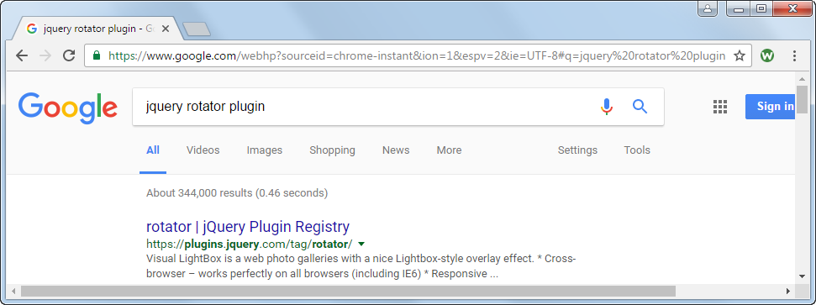
A Google search for a jQuery plugin

Slide 5
Websites for finding jQuery plugins

Slide 6
Popular plugins for displaying images

Slide 7
General steps for using a plugin within your web pages

Slide 8
Two cautions when using plugins

Slide 9
The script elements for the jQuery library and the bxSlider plugin

Slide 10
The HTML for the bxSlider plugin

Slide 11
The jQuery for using the bxSlider plugin

Slide 12
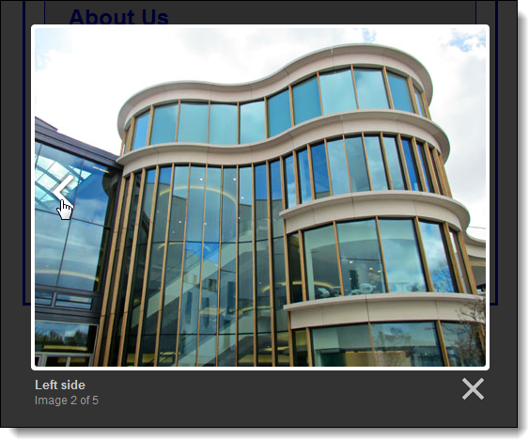
A Lightbox plugin

Slide 13
The URL for the Lightbox website

Slide 14
The HTML for the images used by the Lightbox plugin

Slide 15
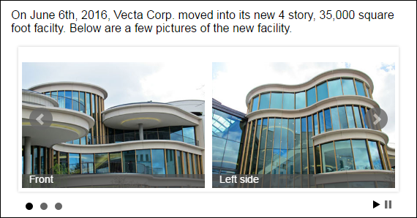
A bxSlider plugin for a carousel

Slide 16
The URL for the bxSlider website

Slide 17
The HTML for the bxSlider plugin

Slide 18
The jQuery for using some of the bxSlider options

Slide 19
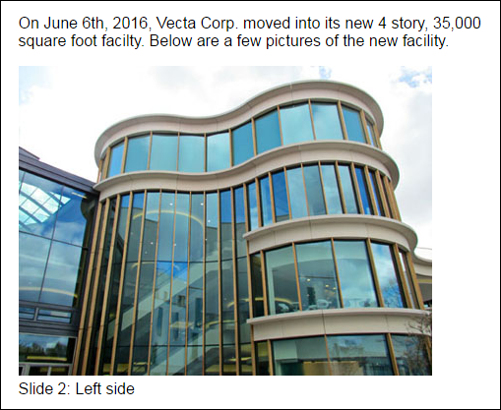
A Cycle 2 plugin used for a slide show

Slide 20
The URL for the Cycle 2 website

Slide 21
The HTML for the Cycle 2 plugin

Slide 22
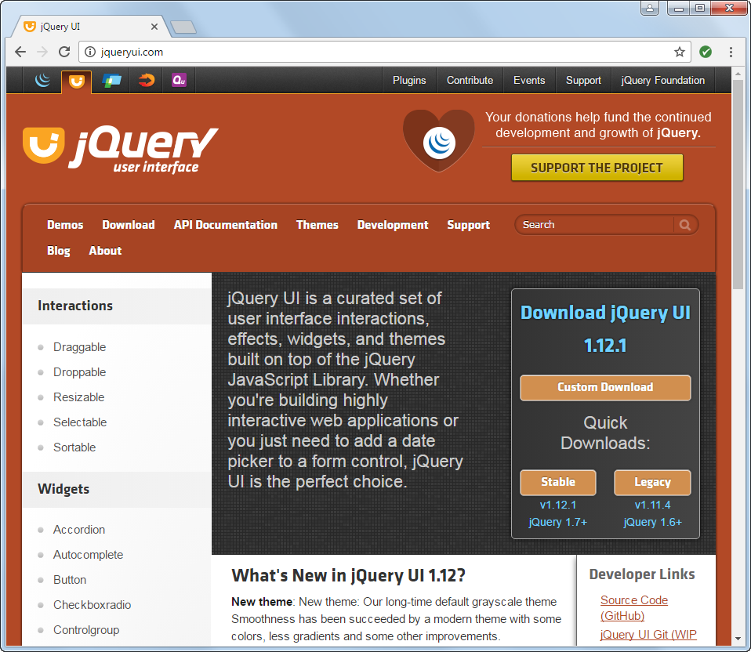
The jQuery UI website (http://jqueryui.com)

Slide 23
The four types of features provided by jQuery UI

Slide 24
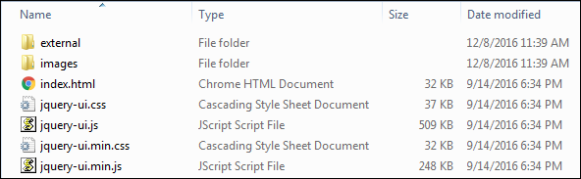
The primary folders and files in a full jQuery UI download

Slide 25
How to build a jQuery UI download

Slide 26
How to include the downloaded files in your application

Slide 27
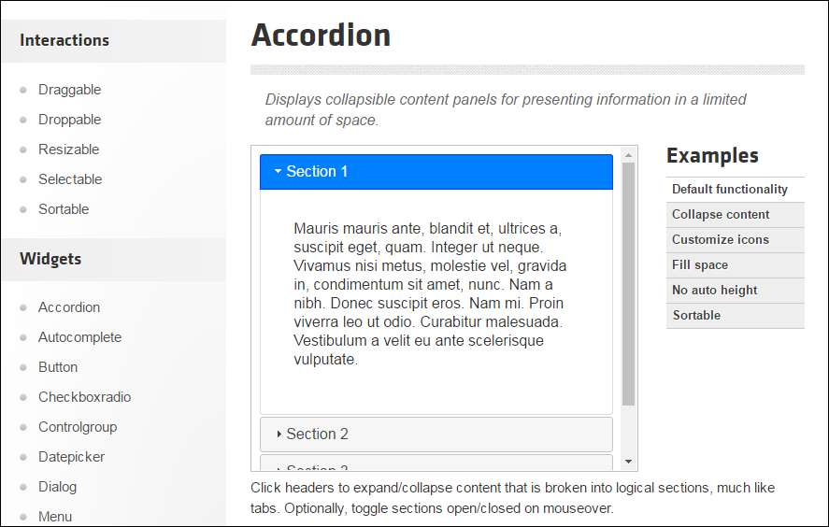
The accordion documentation

Slide 28
How to use the jQuery UI documentation

Slide 29
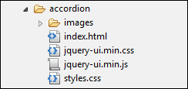
The images folder and jquery-ui.min.css relationship that jQuery UI expects

Slide 30
The jQuery for using a widget

Slide 31
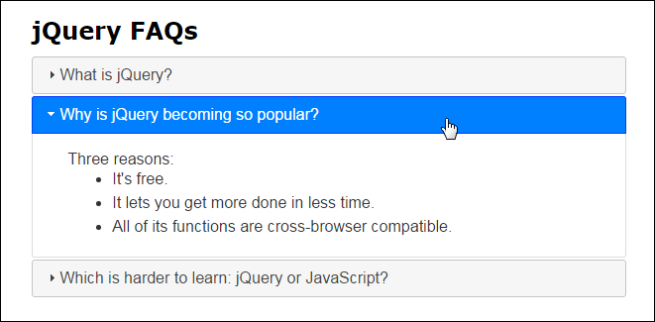
An Accordion widget

Slide 32
The HTML for the accordion

Slide 33
The jQuery for the accordion

Slide 34
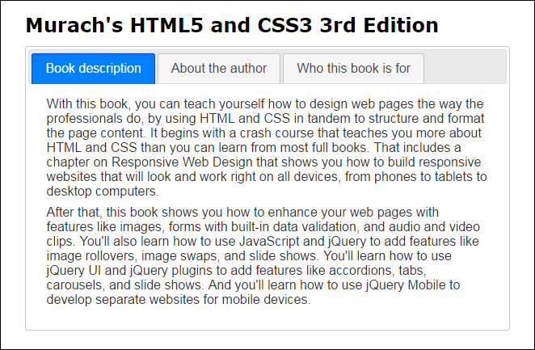
A Tabs widget

Slide 35
The HTML for the tabs

Slide 36
The jQuery for the tabs

Slide 37
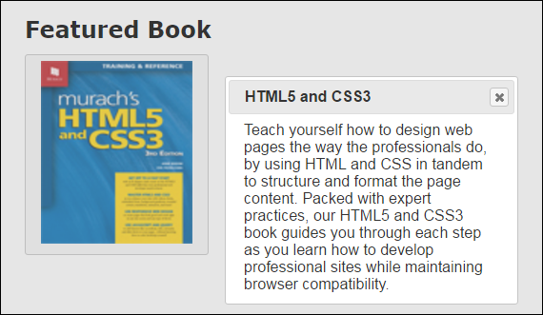
A Button widget that activates a Dialog widget

Slide 38
The HTML for the Button and Dialog widgets

Slide 39
The jQuery for the Button and Dialog widgets

Slide 40
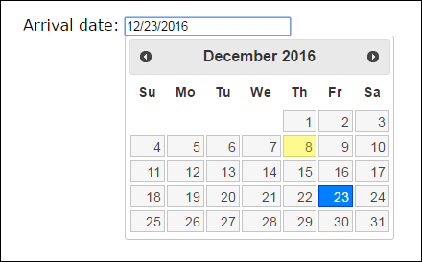
A Datepicker widget with no options set

Slide 41
The HTML for the Datepicker widget

Slide 42
The jQuery for the Datepicker widget

Slide 43
Extra 11-1 Modify the Carousel application

Slide 44
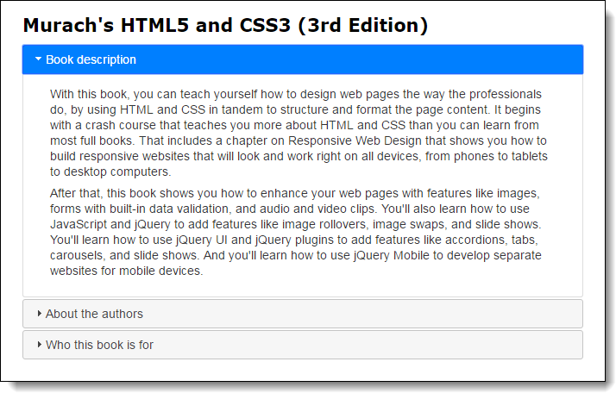
Extra 11-2 Replace tabs with an accordion

Slide 45
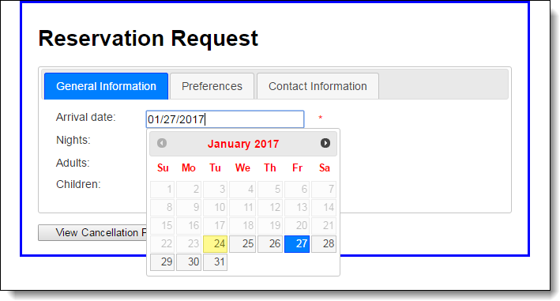
Extra 11-3 Use widgets in a form

Slide 46
Short 11-1 Convert the FAQs app to an accordion

Slide 47
Short 11-2 Create a Progressbar widget

